Slide 1
INTELLIGENCE ANALYTICS CHALLENGE
Team:
PARANORMAL DISTRIBUTION
Members:
ADITI MANDOWARA
ADITYA MURALI
DEEPANJIT KOHLI
POOJA ARORA

Slide 2
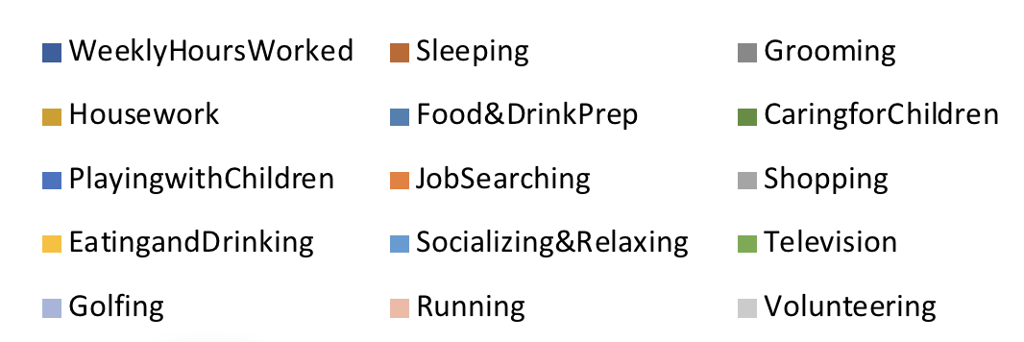

Slide 3
Age 0-19 years | Age 20-29 years
Majority of the people belonging to the age group 0-19 prefer to spend their time sleeping. The second most preferred activity is Working Weekly. We can safely assume that the people who spend their time working must be between the age of 13 years and 19 years since this would include High School graduates and freshers in college. Socializing is the third most preferred activity to pass the time among this age group. The result as a whole give us an insight to the lifestyle of people belonging to this age range. | This age group consists of people who have either just started their career or are pursuing their higher studies. The pie chart indicates that more than half of the people from this age group spend their time working. The next most preferred way to spend time for this age group is Sleeping. This gives us a clear indication that the mindset of people belonging to this group is majorly to earn a living. Even though Socializing and Relaxing is still the third most preferred activity, it corresponds to a fairly small percentage of people.
Age 30-39 years | Age 40-49 years
The people in the previous age group, who were pursuing their studies in their twenties must have graduated by the time they reach their thirties. Thus, there should be an increase in the people who spend their time working. Supporting this notion, the pie chart shows a trend similar to the one we saw for the previous age group. 61% of the people in this age group are working. Sleeping, though is still the second most preferred way to spend time, the percentage has dropped from 20 % for age group 20-29 to 17% for age group 30-39. Another thing to note here is that as and when the age increases, fewer people prefer sleeping as a way to spend their time. It can be safely assumed that this age group is even more work oriented than the age group 20-29. | Similar to the age group 30-39, in this age group too, working is the most preferred way to spend time. Sleeping still remains the second most preferred activity among this age group. We do see a slight increase in the percentage of people considering Television as their preferred time pass activity. This age group similar to the previous two age groups considers working to be of utmost importance.

Slide 4
Age 50-59 | Age 60-69
The people belonging to this age group usually have kids that would fall between the age 15-25. People who have their business start involving their children who are usually in their twenties into their business. While people with service or government jobs would still be working during this time. This range can also include people who have retired (retirement age range is from 58 years to 62 years depending on the country). The pie chart shows a drop in the percentage of people considering working to be the most preferred activity to spend time. Sleeping, still the second most preferred activity, sees an increase of 1% in the percentage of people. Apart from this, we also see an increase in the various other activities like Television, Socializing and Relaxing and grooming. This indicates that people belonging to this group start to take their time off work and use it in other different ways. | A significant drop (from 59 % for age 50 -59 to 41% for age 60 – 69) in the percentage of people who prefer to spend their time working. This age group would have retired professionals and also people who no longer work in their business actively, the drop seems justified. There also is an increase in the different leisure activities like Sleeping, television, Eating and drinking, Socializing and Relaxing. This also is the first age group to show any interest in Volunteering.
Age 70-79 | Age 80+
There is a drastic change of preference in this age group. Sleeping once again becomes the most preferred activity to pass time followed by Socializing and Relaxing. Working becomes the third most preferred activity amongst this group. Watching television too sees a leap from 10% for the previous group to 15 % for this age group. Eating and drinking also sees an increase in the percentage. We can deduce that as and when we grow older, our preferences change. Another important deduction is that with people getting older, their preferences get similar to those belonging to the age group of 0-19 years. | This age group too focuses on Sleeping as the most preferred activity to pass the time. This is followed by Socializing and Relaxing which is similar to the previous age group. Only 3% people prefer working as a way to pass their time. There is an increase in watching television and eating and drinking, Food and drink and housework. As pointed out before, with the increase in age, human preference tends to keep getting similar to the preferences of age group 0-19 years. Another deduction that can be made is that Sleeping remains either the most or the second most preferred activity to pass time across all age groups.

Slide 5
INFERENCES BASED ON EMPLOYMENT
Employed | Unemployed | Not In Labor Force

Slide 6
Employed:
Majority of the employed people preferred to spend their time working.
Sleeping is the second most preferred activity among the employed people.
Socializing and television follow sleeping in the respective order.
Many activities such as Playing with children, golfing, running and volunteering are not popular among the employed people.
This gives us an insight to the lifestyle of the employed people in our society.
It can be safely deduced that employed people don’t give leisure or fitness activities like golfing, running much priority.
Unemployed:
Contrary to the employed people, majority of the unemployed people tend to prefer sleeping as the way to spend their time.
Socializing and Relaxing is the second most preferred activity. This is followed by Television.
Golfing, running and working are not preferred by anyone belonging to this group in the sample.
Similar to the employed people, physical and leisure activities are not popular among the unemployed.
Not in Labor Force:
This category will include retired persons, students, those taking care of children or other family members, and others who are neither working nor seeking work.
We should see some similarity in this group and the unemployed group. Supporting this, the pie chart shows that Sleeping still remains the most preferred activity for this group.
This is followed by Socializing and Relaxing. Television is the third most preferred activity among this lot.
We see a very minimal increase in the percentage of people who prefer activities housework and eating and drinking.
Leisure and physical activities like running and golfing are opted by none in this sample data.

Slide 8
9th Grade | 10th Grade
In the times when Education is the biggest determinant of one’s career, people who are not as qualified would ideally not be work oriented. This is seen from the pie chart. Majority of these people prefer sleeping. Working is the second most preferred option and socializing and relaxing is the third most popular activity among this lot. Only 1% of them spend their time searching for jobs. Activities like volunteering, golfing, running are not opted by anyone in this group. | Similar to the people with 9th grade education, majority in this group prefers to spend their time sleeping. Working and Socializing come second and third most preferred activities.
11th Grade | 12th Grade
People with this level of education show some interest in Working. Working is the most preferred activity in this group. This is followed by Sleeping and then by Socializing and Relaxing. | There is a drastic increase in the percentage of people who prefer to work to spend their time. Sleeping still remains the second most preferred activity. Also to note is that as the education level increases, the number of people who prefer to spend their time working also increases
High School | Some College
Working still remains the most preferred activity . People spending time watching television has dropped considerably for this group when compared with 9th grade people. Similar to other groups Sleeping and Socializing are the second and third most preferred activity . | People who have some particular degree from a college still are better qualified than the ones who haven’t even gone to college. This means that they should be better qualified for certain jobs. This is supported by the fact that 52% of the people belonging to this group prefer to spend their time working. Sleeping remains the second most preferred activity

Slide 9
Associate Degree | Bachelor Degree
More than half of the people with an Associate Degree prefer to spend their time Working. This is obvious as people with higher degree are better qualified for certain jobs. Thus people belonging to this group would ideally have stable regular jobs. Considering this, we can see that 55% of these prefer to spend their time working. Even though sleeping and Socializing are second and third most preferred activities, their respective percentages are quite low. | The trends in this group are very much similar to the trends in the Associate Degree group. Here too, the majority prefer to spend their time working. People with bachelors degree either land a job or prefer to study further. 59% prefer to spend their time working. Sleeping is still the second most preferred activity to spend time among this group
Masters Degree | Doctoral Degree
People with the masters degree are considered to be specialists in the field that they pursue. Working has to be the preference of the majority here. Even though Sleeping and Socializing are second and third most preferred activities, their percentages are quite low. This is obvious as people with Masters degree often have high ranking jobs with a lot of work load. | People with Doctoral Degrees are considered experts and often go into Research or similar jobs. Working, obviously is the most preferred way to spend time among this lot. Sleeping , though second most preferred, has very low percentage corresponding to it. The same goes for Socializing and Relaxing.
Professional Degree
Similar to masters degree, people who have a professional degree in a particular field are considered specialists in their field. Working still remains the most preferred activity for this lot. This group shows the maximum percentage for number of people who prefer working across all groups. 67% of people belonging to this group opt to work to spend their time. Also to be noticed is that this also is the group with the lowest percentage of people who prefer to spend their time watching television. Sleeping and Socializing and Relaxing remain the second and third most preferred activities but their percentages are the least similar to the people belonging to the Doctoral degree group. We can safely deduce that as the education level gets higher, the percentage of people preferring to spend their time working increases. Higher education would help people get better jobs that pay more and thus would mean that demand more work. Also, doctoral and professional degree holders, do not prefer Socializing and Relaxing much. The percentage corresponding to Sleeping and Socializing keeps dropping . Also, irrespective of education, Sleeping remains either the most preferred or the second most preferred activity amongst all.

Slide 10
Analysis of time spent on Baby Care
In our analysis to model the time spent on baby care with respect to other variables, we have considered a subset of the data where the ‘Number of Children is greater than 0’
Also as the data range is very large, we performed winsorization to reduce the effects of extreme values and make the model more robust to outliers
From the above matrix, we can say that there is a negative correlation between weekly hours worked, weekly earnings and the time spent for baby care.
This implies, as the number of weekly hours worked increases, the time spent with children reduces as the person spends more time at work.
This observation is as expected, but the correlation value observed is very small because of the huge variability in the data
CORRELATION MATRIX | Caring for Children
Weekly hours worked | -0.08
Weekly Earnings | -0.02

Slide 11
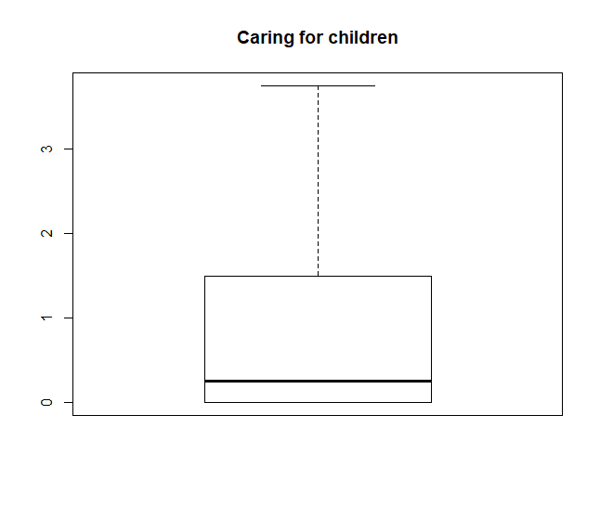
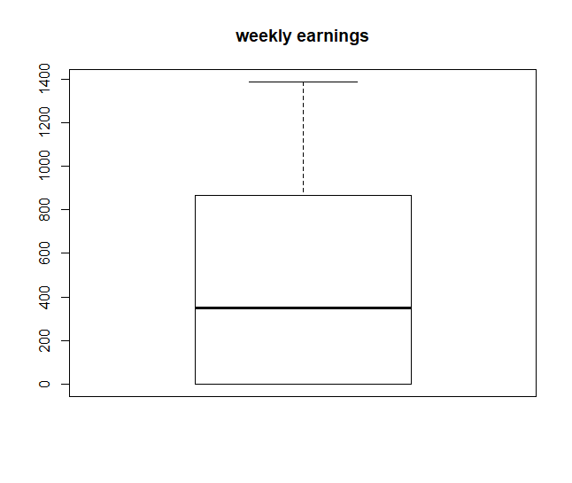
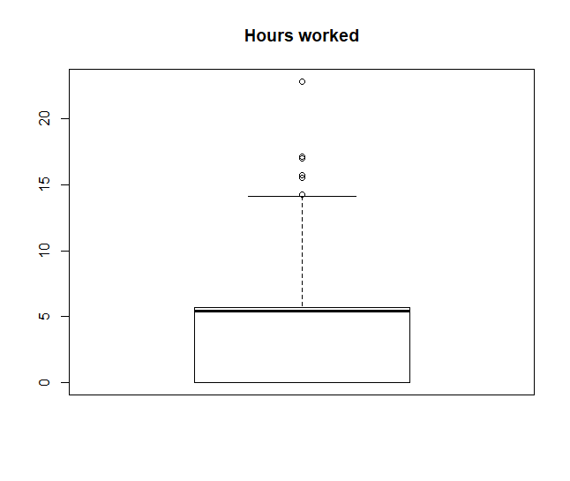
Analysis of time spent on Baby Care
Process of Winsorization
We performed winsorization for the variables caring for children and weekly earnings as they had significant number of outliers in the data set
Weekly hours worked had very few outliers, as seen above and hence the outlier were not transformed and were considered as it is

Slide 12
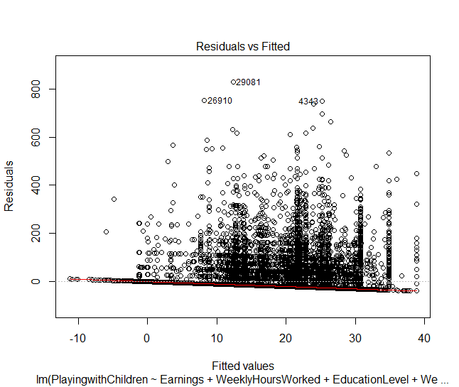
Analysis of time spent on Baby Care
The regression model consists of following explanatory variables:
Weekly Earnings
Weekly hours worked
Education level
An interactive variable of Weekly earnings and weekly hours worked
Observations from the model:
All the variables are highly significant at 95% confidence interval except the Education level of 9th grade
The explanatory variables explain the variation in the time spent on baby care by just 2.5%.
This value being very small does not really signify any strong relation between caring for children and weekly hours worked, weekly earnings and education level

Slide 13
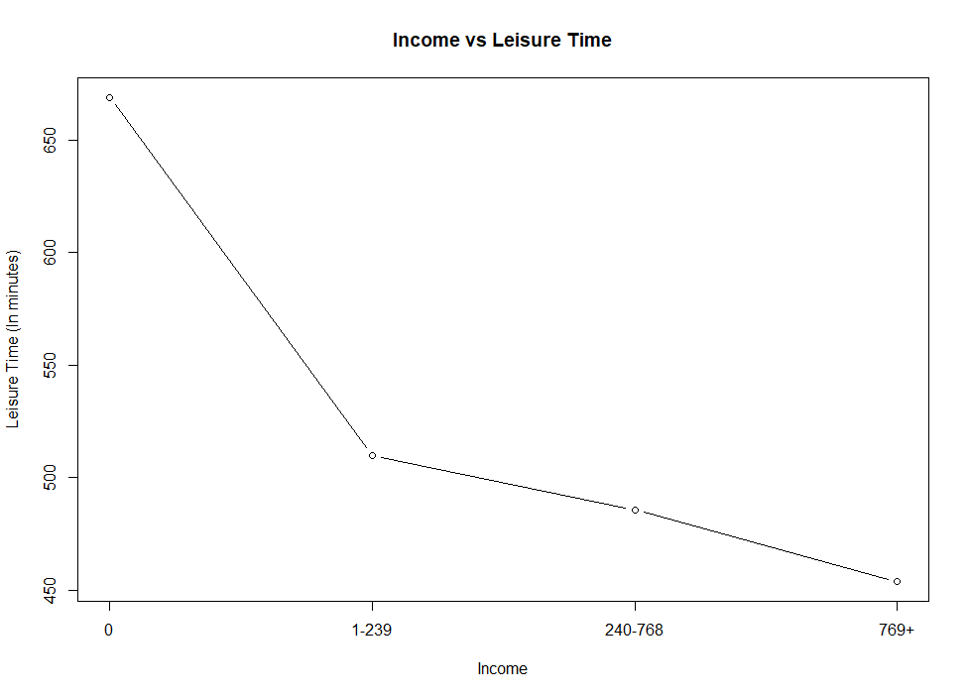
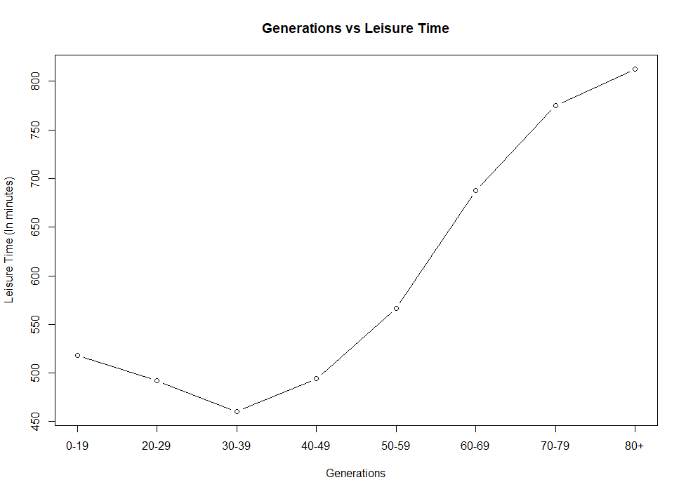
Q4: How does leisure time change based on income and is there a difference between generations leisure spending time?
Assumptions:
Leisure time is considered as the time spent on Shopping, Eating, Drinking, Socializing, Relaxing, Watching Television, Playing golf, Running and Volunteering.
Income as an attribute has a wide range that spreads from a minimum value of 0 to a maximum value of 2885. In order to simplify the problem we have binned income data based on their quantile values.
Time spent on leisure activities is lowest for the age group 30-39. This age group represents the peak working age.
For all generations above the age of 40, the time spent on leisure activities increases with age.
Leisure time decreases as we go from the ages 0 through 30, indicating education and entry into the labour force.
As the income increases, the time spent by a person on leisure activities decreases.

Slide 14
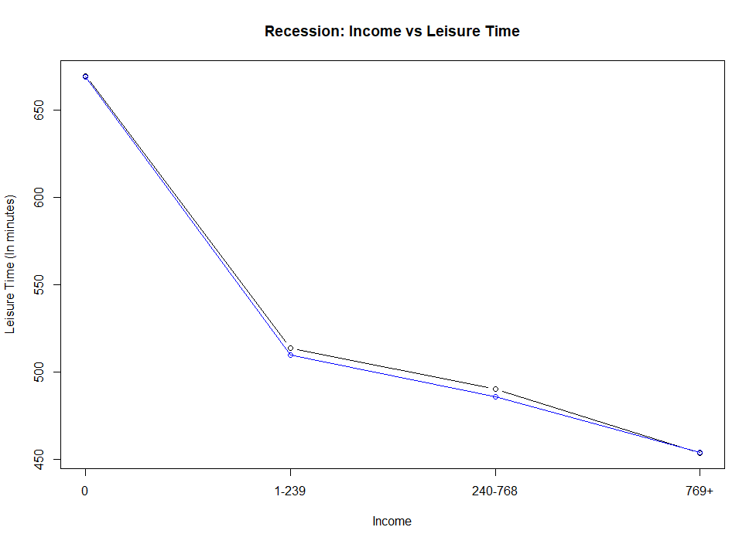
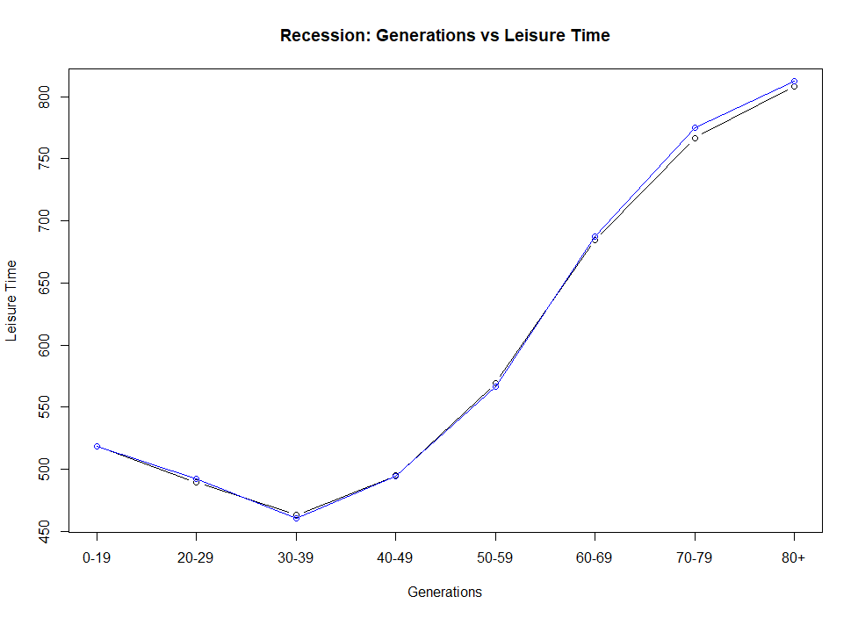
Q5: Is there any change in the pattern when the great recession happened? And if yes, then has that continued?
Assumptions:
The impact of recession is considered over the years 2007-2009.
Average variation across entire dataset timespan
Average variation across recession years 2007-2009
It can be seen from the plots that there is no significant variation in the pattern during the recession years with respect to the average over the entire timespan from 2005 – 2012.

Slide 15
Q6. Based on age what is an individual’s primary activity
Assumptions:
The maximum of Average time spent on all activities indicates individual’s primary activity.
Activities include :- Weekly Hours Worked, Sleeping, Grooming, Housework, Food & Drink Prep, Caring for Children, Playing with Children, Job Searching, Shopping, Eating and Drinking, Socializing & Relaxing, Television, Golfing, Running, Volunteering
 | Working | Sleeping | Grooming | Housework | Food_&_Drink_Prep | Caring_for_Children | Playing_with_Children | Job_Searching | Shopping | Eating_and_Drinking | Socializing_&_Relaxing | Television | Golfing | Running
0-19 | 69.23 | 579.3 | 46.38 | 16.03 | 9.26 | 7.02 | 2.43 | 0.84 | 18.04 | 55.53 | 294.17 | 137.48 | 1.07 | 2.56
20-29 | 240.01 | 542.84 | 41.16 | 35.11 | 26.76 | 50.18 | 17.3 | 2.28 | 23.3 | 62.32 | 257.52 | 141.07 | 1.12 | 0.84
30-39 | 276.3 | 517.51 | 38.07 | 44.28 | 38.32 | 70.62 | 21.51 | 2.16 | 26.8 | 67.73 | 227.97 | 128.4 | 0.77 | 0.76
40-49 | 284.33 | 506.96 | 39.51 | 45.14 | 37.36 | 35.4 | 7.47 | 2.08 | 26.26 | 67.3 | 244.28 | 143.57 | 1.2 | 0.8
50-59 | 254.09 | 507.41 | 40.79 | 41.49 | 34.33 | 7.96 | 1.45 | 2.33 | 25.55 | 67.53 | 287.29 | 174 | 1.47 | 0.46
60-69 | 129.69 | 515.8 | 41.25 | 43.95 | 35.41 | 2.86 | 0.68 | 0.82 | 25.1 | 74.3 | 359.34 | 214.65 | 2.15 | 0.18
70-79 | 33.76 | 527.8 | 41.3 | 46.69 | 41.63 | 1.14 | 0.38 | 0.05 | 23.57 | 80.01 | 414.91 | 239.95 | 1.92 | 0.1
80+ | 10.02 | 546.22 | 43.98 | 43.8 | 41.87 | 0.16 | 0.02 | 0.15 | 17.31 | 85.57 | 448.86 | 248.91 | 0.81 | 0
Average time spent on each activity by Age Group
It can be interpreted from the table above that all the Age Groups spend most of the time on Sleeping when compared with other activities in dataset. Graphical representation on following slide.

Slide 17
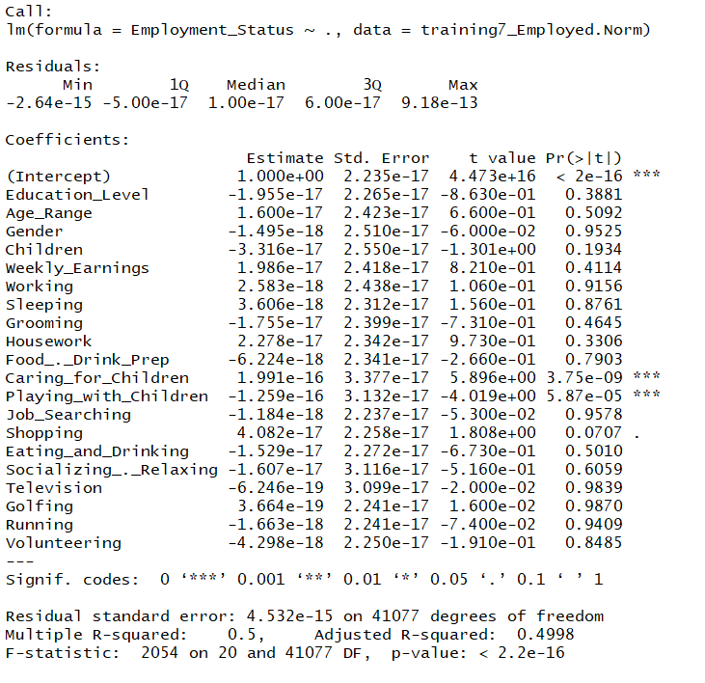
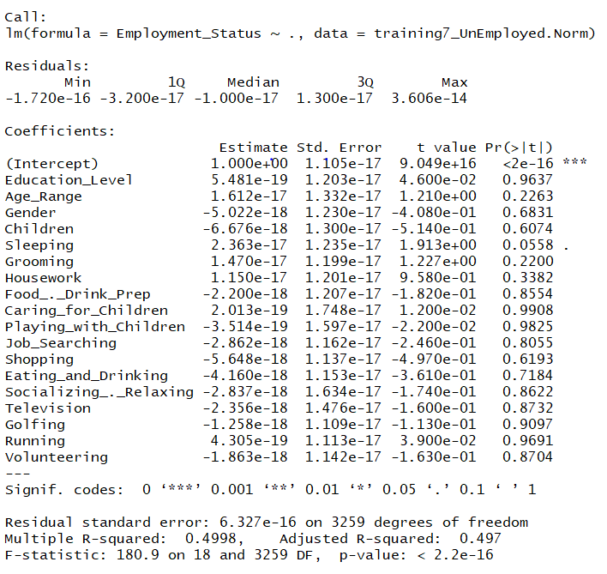
Q7. Which is the most significant variable effecting the employment as well as unemployment
Assumptions:
1. Linear modelling the employed and unemployed against the factors present in the dataset to interpret the influence of various data points.
Summary Statistics for Employed
Summary Statistics for UnEmployed
Interpretation:
No. of hours spent on caring for children contributes significantly in a positive manner to the employment status
No. of hours spent on playing with children contributes significantly in a negative manner on the employment status
Interpretation:
No. of hours spent on sleeping by an individual contributes significantly to the unemployment status

Slide 18
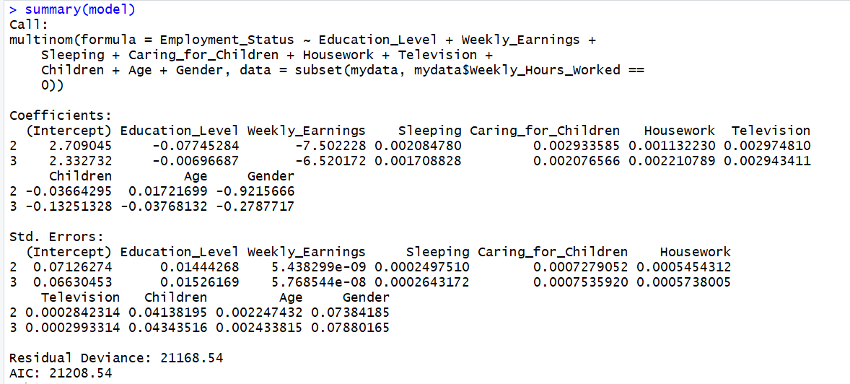
Result of multinomial regression.
T value = Beta / Sigma
A very high t value means a very low p value, which implies that the null hypothesis that independent variable is not significantly related to the dependent variable is rejected.
Weekly Earnings has the smallest value of Sigma.
Thus Weekly Earnings has a very high t value. This implies that Weekly Earnings is the most significant variable related to Unemployment.
Beta
Education | Weekly Earnings | Sleeping | Caring for Children | Housework | TV | Children | Age | Gender
-0.07745284 | -7.502228 | 0.00208478 | 0.002933585 | 0.00113223 | 0.00297481 | -0.03664295 | 0.01721699 | -0.9215666
Sigma
Education | Weekly Earnings | Sleeping | Caring for Children | Housework | TV | Children | Age | Gender
0.01444268 | 5.44E-09 | 0.000249751 | 0.000727905 | 0.00054543 | 0.000284231 | 0.04138195 | 0.002247432 | 0.07384185
t value
Education | Weekly Earnings | Sleeping | Caring for Children | Housework | TV | Children | Age | Gender
-5.362774776 | -1379517382 | 8.347434044 | 4.030174534 | 2.075843846 | 10.46615539 | -0.885481472 | 7.660739012 | -12.48027507

Slide 19
Prediction model for Test Dataset
As Employment Status is categorical data, we made use of multinomial logistic regression to predict the values in Test Dataset
For our prediction, we choose random sampling method to select a sample of size 33270 from the training dataset
Considering ‘Employed’ status as our reference point, we factorized this variable and build our prediction model on it
We considered combinations of various explanatory variables and chose our model on the basis of prediction accuracy and Bayesian Information Criterion(BIC)
The explanatory variables considered in the final model are:
JobSearching
Age
Gender
Socialising and Relaxing
The model has predicted values of Employment Status with an accuracy of 65% and BIC value of 21410.13

Slide 20
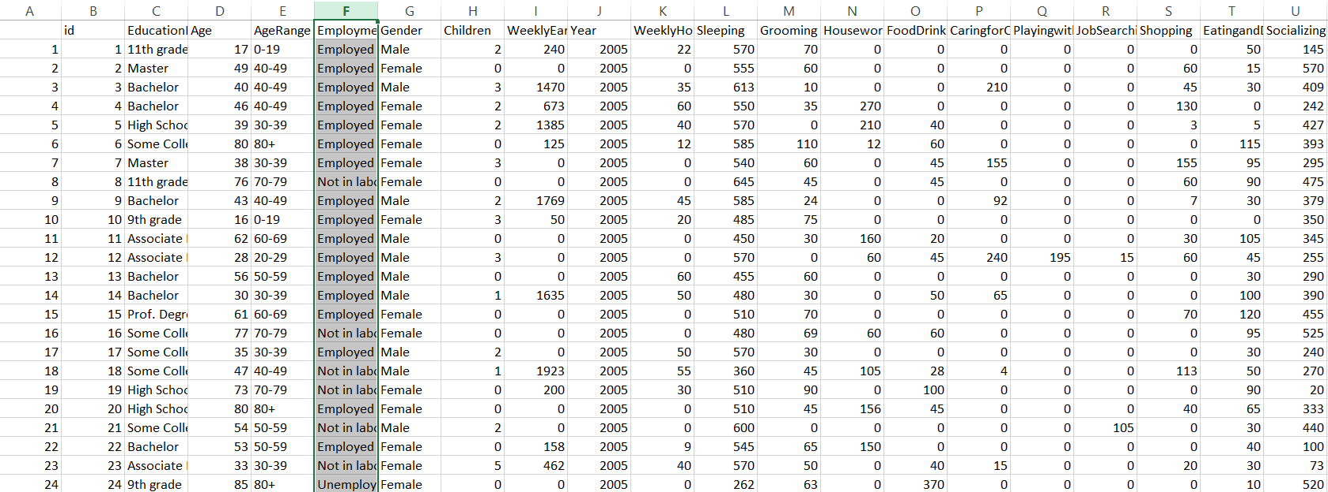
The results of the prediction can be found in the file TestOutput.csv

Slide 21
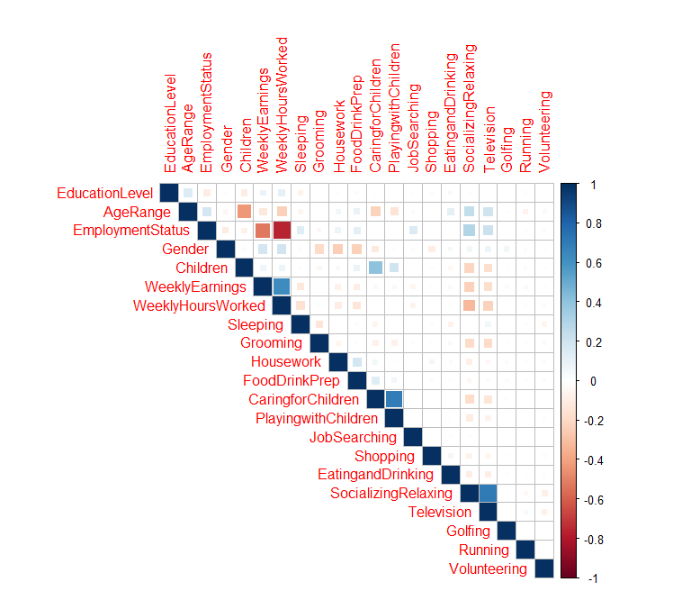
Additional findings – Correlation between variables of the data set
We have visualized the correlation matrix for variables given in the dataset to graphically find relationships between the variables.
Darker the shade of Blue, the stronger is the positive correlation between the variables.
Darker the shade of Red, the stronger is the negative correlation between the two variables.
We can see that there are strong positive relationships between:
Weekly Earnings and Weekly Hours Worked
Having Children and Caring for Children
Caring for Children and Playing with Children
Socializing & Relaxing and Watching Television
We can see that there are negative relationships between:
Weekly Earnings and Socializing & Relaxing
Weekly Hours Worked and Socializing & Relaxing
Employment Status and Weekly Hours Worked, Weekly Earnings
We have factorised Employment status into a numeric representation where 3 = Unemployed, 2 = Not in Labor Force and 1 = Employed. Thus if Employment status increases from 1 to 3, the hours worked and earnings would drop thereby explaining the negative relationship.

